Slide 1
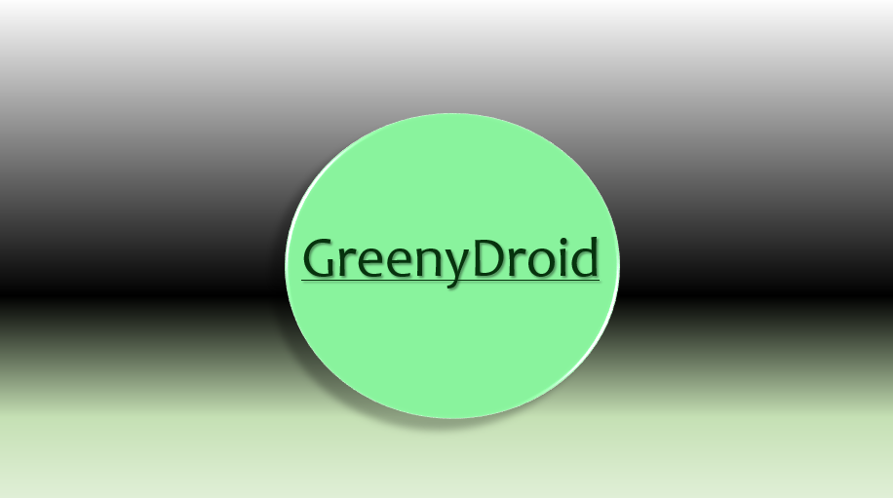

If you want to learn more about Android…
…with challenge!!!
…with an entertainment!!!

Slide 2

MIGHT BE THE BEST APPLICATION FOR YOU!!!
GreenyDroid
So, what GreenyDroid can do?

Slide 3
So what can GreenyDroid can do?

